Slide 1

HUMAN MEMORY!!!!
CREATED BY:
Abhijith n raj

Slide 2
What is Memory?
Learning that has persisted over time and information that has been stored and in many cases can be recalled
Memory is acessed though three ways:
Recall , Recognition and Re learning
But How does this data become a Memory?
Notes:
All the exams in the school and college are designed to size up how to access these memories l
RECALL: like fill in the blanks which is the capital of Greece is Athens
Recognition: Identifying old information when presented with it like the mcqs
Relearning : Reinforcing old info ike studying for final exams
We are being exposed everyday to vast array of potential information.

Slide 3
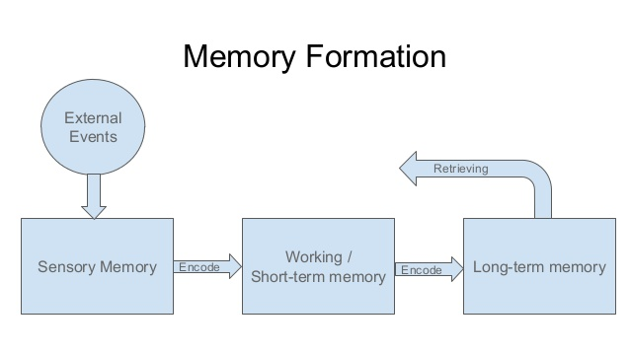
BUT HOW EXACTLY DOES SHORT TERM MEMORY WORKS?
Notes:
Encoded into the brain stored for future uses and then retrieived .
Just because we take it for granted doesn’t mean that these process isnt complicated.
What we need to remember is an immediate but fleeting sense of memory like who is the president of UN right now
If you remember who it is it is because you successfully encoded it to your short term memory
This is how you briefly remember something like a password or phone no (like 30 s)
At this point memory either decays or gets transfrerred to long term memory
Long Term Memory is brains Durable but rifdiculously huge storage unit

Slide 4
WORKING Memory
SHORT TERM MEMORY
IMPLICIT PROCESSES
EXPLICIT PROCESSES
LONG TERM MEMORY
PROCEDURAL MEMORY
EPISODIC
MEMORY
Notes:
EXPLICIT-> When we store information consciously and actively
For example, when we study facts and knowledge that we need
IMPLICIT-> We are not conscious of all the things that we take in yet our working memory actually transfers stuff we are not aware of into long term memory
This is an automatic process like learning not to play with fire
PROCEDURAL MEMORY->These are long term memory that helps us perform an action like learning learning to walk or bicycle. These are difficult to learn at first but recalls with ease once learned
EPISODIC MEMORY-> Specific events of our life like winning an award or losing a loved one

Slide 5
How do we remember?
Memory is like an entangled web of information with interconnected associations that link all sorts of diverse things
Retrieval cues –The more , The better
Memoryless Memory
Context Dependent Memory
State Dependent or Mood Congruent Memory
Serial Position Effect
Notes:
Activating associations non consciously is called priming or memoryless memory
Memory that we didn’t know we had will awaken old memory ->also priming or memoryless memory

Slide 6
Who decides what we remember?
Shallow Processing lets you encode information on the basis of auditory or visual levels, based on the sound structure and appearance of a word.
But if you really want to retain it:
Deep Processing – it encodes based on the actual meaning of the word
To make it really stick connect it to something meaningful to you or related to your own emotional experience.
Factors determining you recall:
Time took to learn and how it is relevant to you

Slide 7

Why do we forget ?
Failure to encode or store
Storage Decay
Retrieval failure(Where retreival cues come in handy)
Interference
Proactive Interference and Retroactive Interference
Motivated forgetting
The Misinformation effect
WHAT? How Can I Prevent this?
Notes:
Our memories may haunt us or sustain us but either way they define us and without them we are left to wonder alone in the dark.
Proactive Interfernce:Old information interfering with the new information
Retroactive: New information interfering with old information eg: learning a new language

Slide 8

Exceptional Memories
Photographic Memory
Eidetic Memory
Conditions such as Hyperthymesia

Slide 9
Memory Techniques
Link Method
Story Method
Loci Method
The Peg system
Mind Map
Memory Palace
Notes:
Link Method-> Remembering by creating association between things
Loci Method->Associating Objects to Familiar locations

Slide 10

Keep Making Sweet Memories
THANK YOU

